Slide 1
BSCS- 501: Theory Of Computer Science
Credit Hour (2+1)
Department Of Computer Science
University Of Karachi

Slide 2
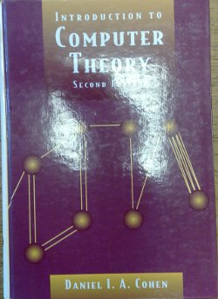
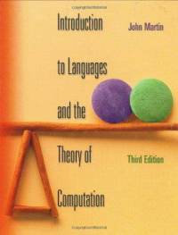
Textbook:
Introduction To Computer Theory
Daniel I. A. Cohen
Introduction to Languages and the Theory of Computation
John C. Martin
Read the textbook!
  Key for learning and obtaining a good grade

Slide 3
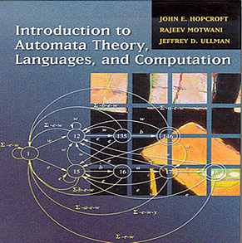
Reference Books
John.E. Hopcroft, R. Motwani, and J.D. Ullman
Introduction to Automata Theory, Language and Computation
Second EditionPearson Education Asia, 2001

Slide 4
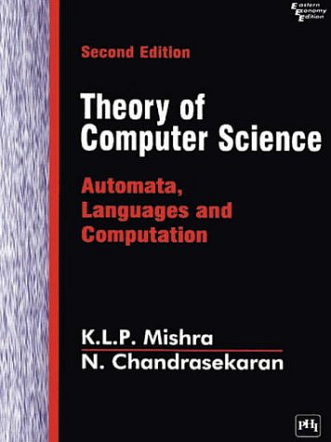
Reference Books
K.L.P. Mishra, N. Chandrasekaran
Theory of Computer Science (Automata, Languages & Computation)
Second Edition
Prentice Hall of India, 1999

Slide 5
Course Objectives
The major objective of this course is to introduce the student to the concepts of theory of computation in computer science. The student should acquire insights into the relationship among formal languages, formal grammars, and automata.
Upon successful completion of this course, students will be able to:
  Apply a number of proof techniques to theorems in language design.
  Develop a clear understanding of un-decidability.
  Understand the equivalence between Nondeterministic Finite State Automata and Deterministic Finite State Automata.
  Understand the equivalence between Context-Free Grammars and Nondeterministic Pushdown Automata.
  Appreciate the power of the Turing Machine, as an abstract automaton, that describes computation, effectively and efficiently.

Slide 6
finite automata | Devices with a finite amount of memory. Used to model “small” computers.
push-down automata | Devices with infinite memory that can be accessed in a restricted way. Used to model parsers, etc.
Turing Machines | Devices with infinite memory. Used to model any computer.
time-bounded Turing Machines | Infinite memory, but bounded running time. Used to model any computer program that runs in a “reasonable” amount of time.

Slide 7
Three Basic Concepts:
Language,
Grammar and
Automata
These three concepts provide the foundation core of the course “Automata Theory”

Slide 8
Languages
Language
Natural Languages
Computer Languages
Mathematical Languages
A general definition of languages encompass all of these various types languages:
A language is a set of strings over an alphabet.

Slide 9
Alphabets
A finite non empty set S of symbols is called alphabet.
A common way to talk about words, number, pairs of words, etc. is by representing them as strings
To define strings, we start with an alphabet
Examples
Σ = {a, b, c, d, …, z}: the set of letters in English
Σ₁ = {0, 1, …, 9}: the set of (base 10) digits
Σ₂ = {a, b, …, z, #}: the set of letters plus the special
symbol #
Σ₃ = {(, )}: the set of open and closed brackets

Slide 10
Strings
From the individual symbols of an alphabet we construct
string, which are finite in nature. or
A string over alphabet S is a finite sequence of symbols in S.
The empty string will be denoted by ε
Examples
abfbz is a string over Σ = {a, b, c, d, …, z}
9021 is a string over Σ₁ = {0, 1, …, 9}
ab#bc is a string over Σ₂ = {a, b, …, z, #}
))()(() is a string over Σ₃ = {(, )}

Slide 11
Strings
Example: Let Σ ={ a, b, c} be the alphabet containing three symbols a , and c.
Then
aaabba and ababac are two strings on Σ.

Slide 12
Languages
L₁ = The set of all strings over Σ that contain
the substring “fool”
L₂ = The set of all strings over Σ₁ that are divisible by 7
= {7, 14, 21, …}
L₃ = The set of all strings over Σ₂ of the form s#s where s is
any string over {a, b, …, z}
L₄ = The set of all strings over Σ₃where every ( can be
matched with a subsequent )

Slide 13
Example
Let us consider some simple examples of languages:
Σ = { x }
We can define a Language:
L_{1:} Any non empty string of alphabet character is a word.
L₁ : { x, xx, xxx, xxxx, ……….}
Alternate form:
L₁ : = { x^{n} for n = 1, 2, 3, ………………}

Slide 14
String Operations:
Concatenation: The concatenation of two strings is the string resulting from putting them together from left to right.
» If u=one and v=two then u · v=onetwo
and v · u=twoone
» Dot is usually omitted; just write uv for u · v.
Laws:
u · (v · w) = (u · v) · w
u · ε = u
ε · u = u
|u · v| = |u| + |v|

Slide 15
Length/Size of String:
» The length of a string is the number of symbols that it contains (repetitions allowed).
» Absolute values are used to denote length.
» The length of a string w is denoted |w|.
» For example |00100| = 5
|aab| = 3
| ε (epsilon) | = 0

Slide 16
Reverse
If a is a word in some language L, then reverse(a) is the same string of letters spelled backward, even if this backward string is not a word in L.
Example:
  reverse(xxx) = xxx
  reverse(145) = 541
Define the language
L₃ = { any finite string of alphabet letters that does not start with the letter zero }
This language L₃ looks like the set of positive integers:
L₃ = { 1, 2, 3, 4, 5, 6, 7, 8, 9, 10, 11, 12, … }
  Note that 140 is a word in L₃, but reverse(140) = 041 is NOT a word in L₃

Slide 17
Definition: Palindrome
Let us define a new language called Palindrome over the alphabet
∑ = { a, b }
PALINDROME = { Λ, and all strings x such that reverse(x) = x }
If we want to list the elements in PALINDROME, we find
PALINDROME = { Λ, a, b, aa, bb, aaa, aba, bab, bbb, aaaa, abba, … }

Slide 18
Sometimes two words in PALINDROME when concatenated will produce a word in PALINDROME
  abba concatenated with abbaabba gives abbaabbaabba (in PALINDROME)
But more often, the concatenation is not a word in PALINDROME
  aa concatenated with aba gives aaaba (NOT in PALINDROME)
The language PALINDROME has interesting properties that we shall examine later.

Slide 19
Kleene Closure
Definition: Given an alphabet ∑, we define a language in which any string of letters from ∑ is a word, even the null string Λ. We call this language the closure of the alphabet ∑, and denote this language by ∑*.
Examples:
If ∑ = { x } then ∑* = { Λ, x, xx, xxx, … }
If ∑ = { 0, 1 } then ∑* = { Λ, 0, 1, 00, 01, 10, 11, 000, 001, … }
If ∑ = { a, b, c } then ∑* = { Λ, a, b, c, aa, ab, ac, ba, bb, bc, ca, cb, cc, aaa, … }

Slide 20
Lexicographic order
Notice that we listed the words in a language in size order (i.e., words of shortest length first), and then listed all the words of the same length alphabetically.
This ordering is called lexicographic order, which we will usually follow.
The star * in the closure notation is known as the Kleene star.
We can think of the Kleene star as an operation that makes, out of an alphabet, an infinite language (i.e., infinitely many words, each of finite length).

Slide 21
Kleene Closure
Let us now generalize the use of the Kleene star oprator to sets of words, not just sets of alphabet letters.
Definition: If S is a set of words, then S* is the set of all finite strings formed by concatenating words from S, where any word may be used as often as we like, and where the null string Λ is also included.

Slide 22
Kleene Closure
Example: If S = { aa, b } then
S* = { Λ plus any word composed of factors of aa and b }, or
S* = { Λ plus any strings of a’s and b’s in which the a’s occur in even clumps }, or
S* = { Λ, b, aa, bb, aab, baa, bbb, aaaa, aabb, baab, bbaa, bbbb, aaaab, aabaa, aabbb, baaaa, baabb, bbaab, bbbaa, bbbbb, … }
Note that the string aabaaab is not in S* because it has a clump of a’s of length 3.

Slide 23
Its Your Turn: ?????
Example: Let S = { a, ab }. Then
S* = { }, or
S* = { }, or
S* = { }

Slide 24
Positive Closure
If we wish to modify the concept of closure to refer only the concatenation of some (not zero) strings from a set S, we use the notation + instead of *.
This “plus operation” is called positive closure.
Example: if ∑ = { x } then ∑⁺ = { x, xx, xxx, … }
∑⁺ = ∑* - Λ
Observe that:
If S is a language that does not contain Λ, then S⁺ is the language S* without the null word Λ.
If S is a language that does contain Λ, then S⁺ = S*
Likewise, if ∑ is an alphabet, then ∑⁺ is ∑* without the word Λ.

Slide 25
Automata
Automata is Greek letters .Automata is a word formulated from automation, which means machine designing or replacing human beings with machines.
Every machine design requires some hardware part and some software part.
A machine could be a finite state machine ,a Turing Machine, a pushdown automata, or any other restricted version of a Turing machine.

Slide 26
http://xml.cs.nccu.edu.tw/courses/Flang/FL2011/ppts/ch1.ppt

